Slide 1
JAVP: Joint-Aware Video Processing with Edge-Cloud Collaboration for DNN Inference
Shuangwei Gao
MM’23, October 29-November 3, 2023, Ottawa, ON, Canada
Zheming Yang, Wen Ji, Qi Guo, & Zhi Wang

Slide 2
Content
Introduction
Motivation
JAVP Architecture
Performance Evaluation
Conclusion
CONTENT

Slide 3
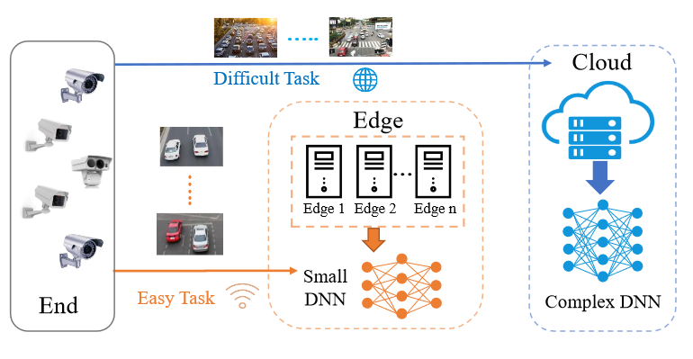
Introduction
Background1:
It is difficult to satisfy tasks with low delay requirements if all tasks are uploaded to the cloud for processing due to limited bandwidth resources.
Background2:
Edge servers with limited resources can usually only deploy small DNN models , which is difficult to meet the accuracy requirements of complex tasks.
However, the current methods rely heavily on known video information and lack aware analysis of complexity.

Slide 4
Introduction
The main contributions of this paper:
propose a multiscale complexity-aware model, which is developed through the renormalization group method. Divide the complexity into three levels 𝐶_{low}, 𝐶_{medium}, and 𝐶_{high.}
develop an adaptive resource-aware optimization algorithm. Optimize the tradeoff between accuracy, delay, and energy consumption.
JAVP can adaptively allot the input task to the optimal server and optimize resource allocation through joint-aware.

Slide 5
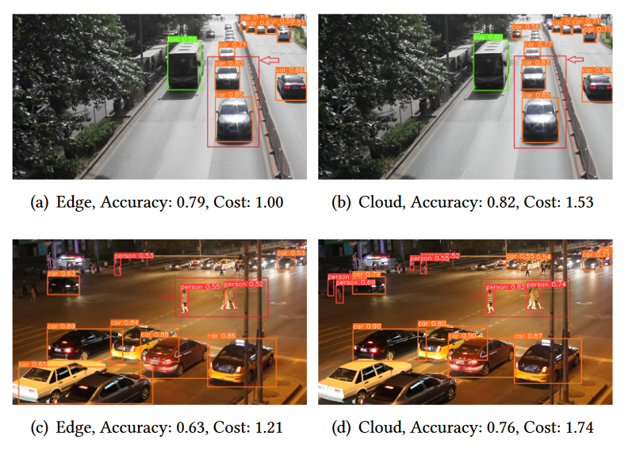
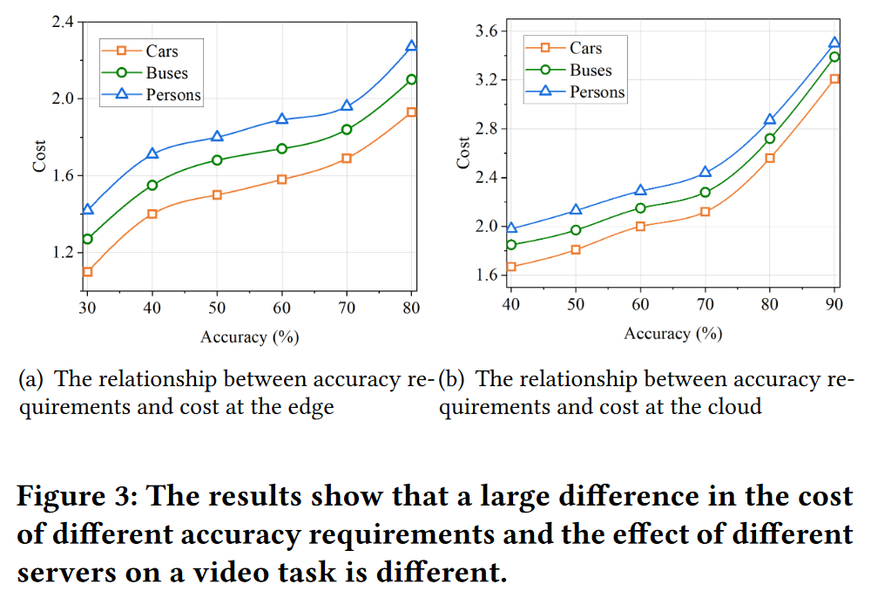
Motivation
Dataset :UA-DETRAC
Edge server deployed with YOLOv5s: NVIDIA Jetson Xavier NX
Cloud server deployed with YOLOv5x: NVIDIA A100 GPU
Accuracy is calculated by mAP50

Slide 6
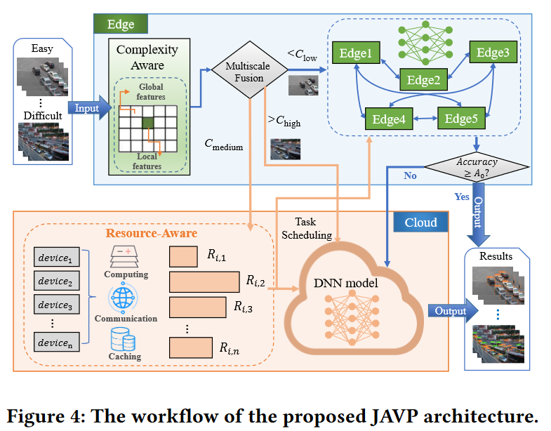
JAVP Architecture
4.1 Overall Design
Use a multiscale fusion approach to obtain the complexity.
The resource allocation strategy : deploy the resource-aware optimization module
JAVP can reduce energy consumption and ensure accuracy through the complexity-aware analysis module. And the resource-aware optimization module is used to guarantee low delay and reduce energy consumption.

Slide 7
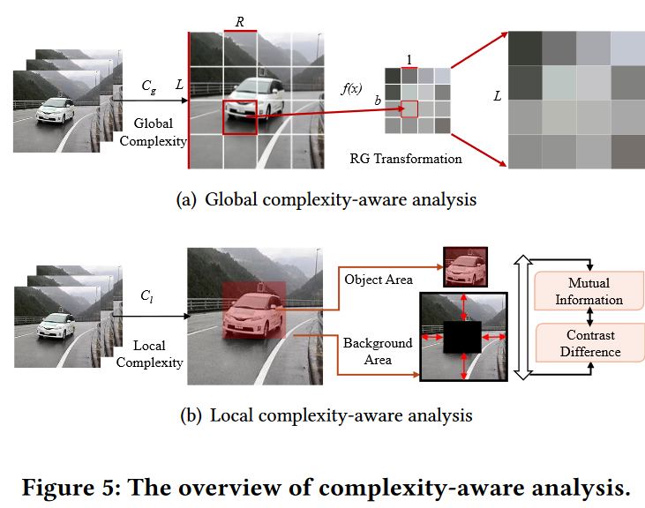
JAVP Architecture
4.2 Multiscale Complexity-Aware Analysis
global complexity :The renormalization group (RG), examine system changes at different scales.
local complexity :mutual information and contrast differences
the results of global complexity and local complexity are combined to get the input task’s scene complexity:
𝐶 = 𝛼 · 𝐶_{𝑔} + 𝛽 · 𝐶_{𝑙}

Slide 8
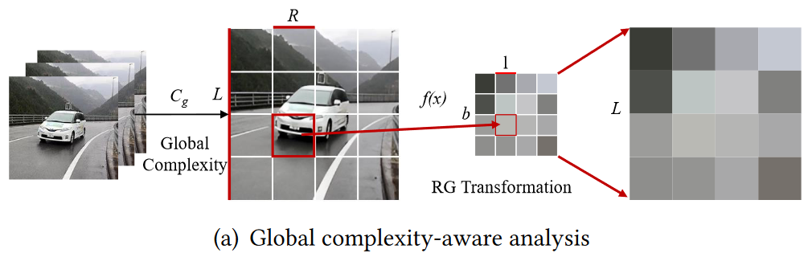
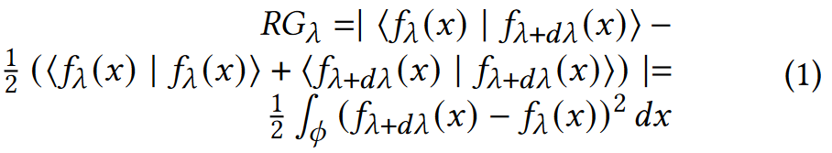
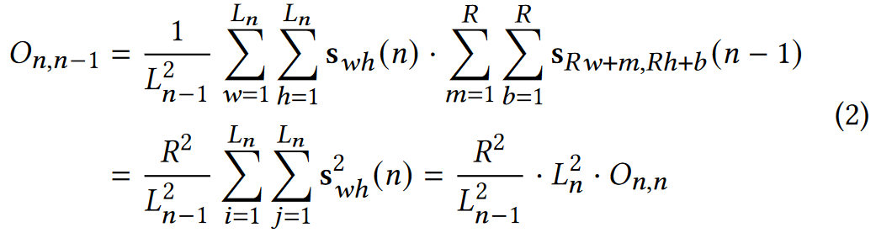
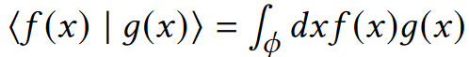
4.2 Multiscale Complexity-Aware Analysis
4.2.1 Global Complexity
The renormalization group(RG) transformation is a mathematical method employed to address the issue of scale variations in physical systems.
Iteration: a series of renormalized images at varying resolutions
a single pixel state:
A scale λ can be considered as a function 𝑓 (𝑥) defined on some image domain 𝜙.
the degree of overlap between images at different scales:
non-normalized overlap of two images of different scales

Slide 9
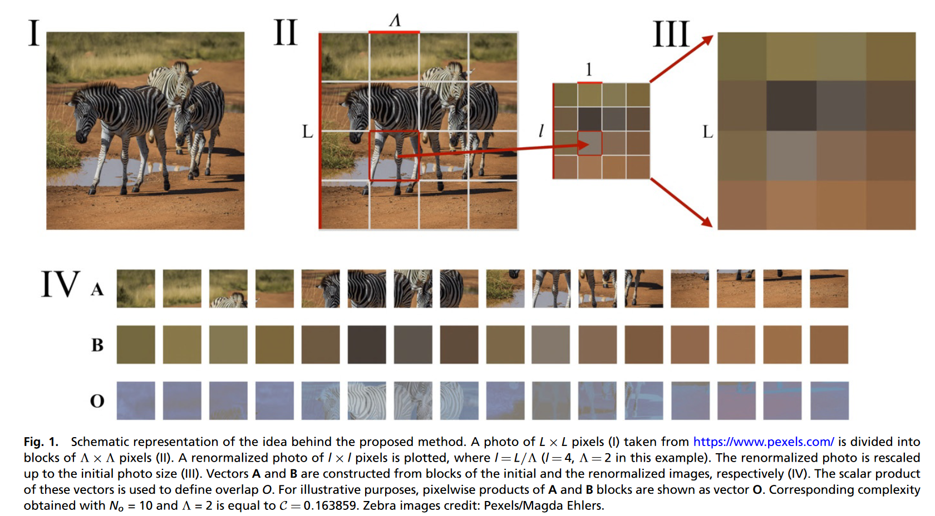
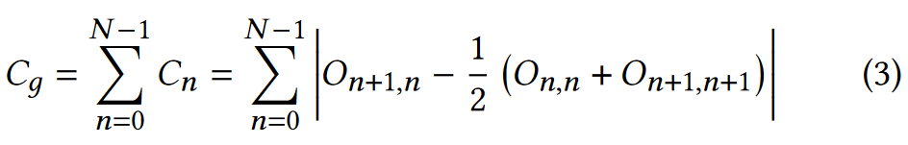
4.2 Multiscale Complexity-Aware Analysis
4.2.1 Global Complexity
global complexity 𝐶_{𝑔}：

Slide 10
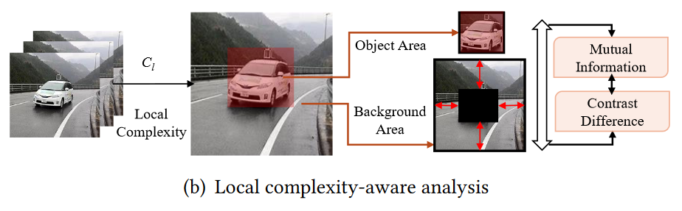
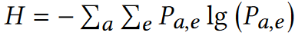
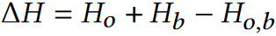
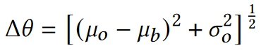
4.2 Multiscale Complexity-Aware Analysis
4.2.2 Local Complexity
the difference between the object area and the background area in the image
The information entropy:
The mutual information:
The contrast difference:
the local complexity of the input task is 𝐶_{𝑙} = 𝛽₁ · Δ𝐻 + 𝛽₂ · Δ𝜃 .

Slide 11
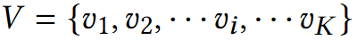
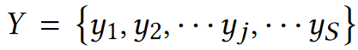
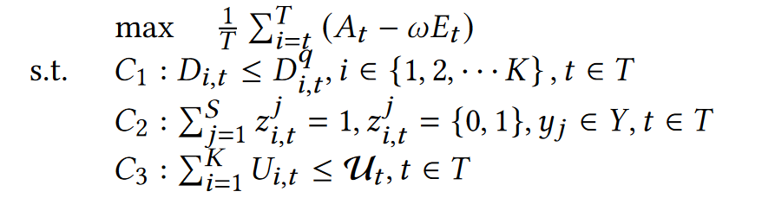
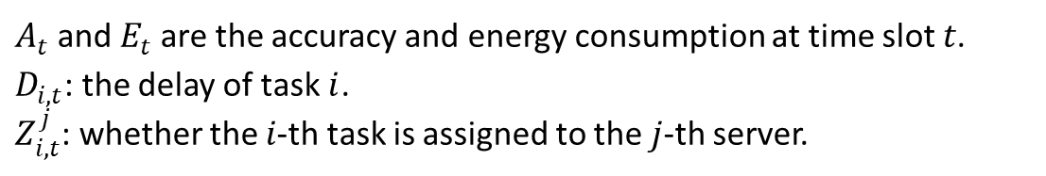
Adaptive Resource-Aware Optimization
4.3.1 Problem Formulation
the video tasks：
Servers：
$A_{t}$and $E_{t}$ are the accuracy and energy consumption at time slot 𝑡.
$D_{i,t}$: the delay of task$i$.
$Z_{i,t}^{j}$: whether the 𝑖-th task is assigned to the 𝑗-th server.
a heterogeneous resource metric model:
𝑈^{tri} = 𝑈^{comp} (𝑣) · 𝑈^{comm} (𝑣) · 𝑈^{cach} (𝑣)
4.3.2 Solution Algorithm

Slide 12
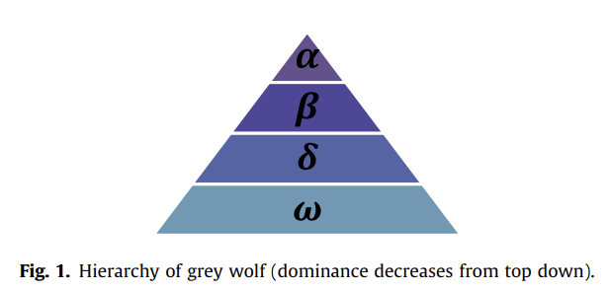
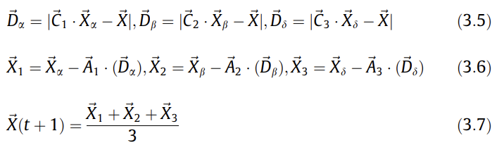
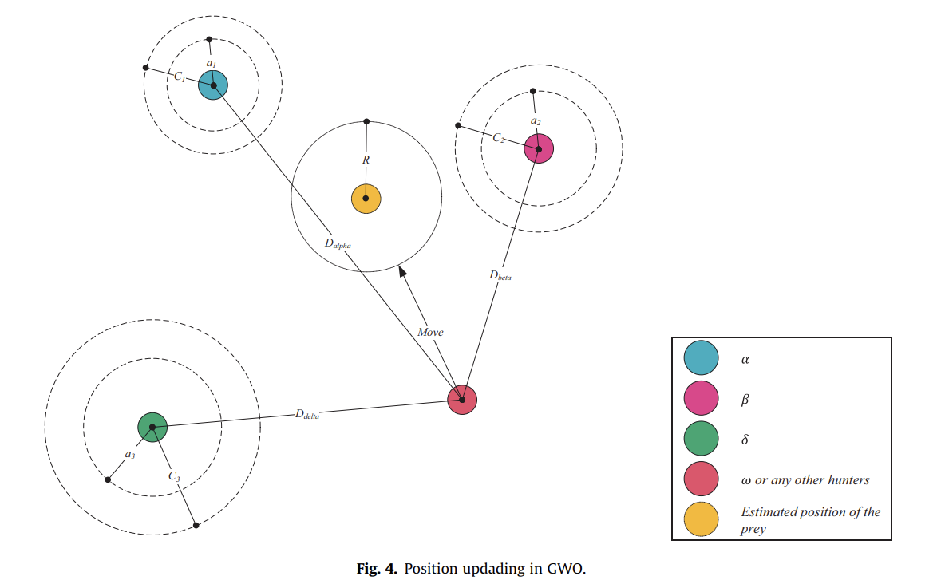
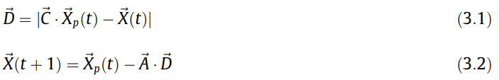
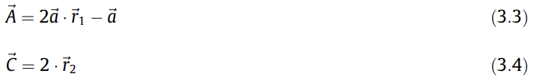
Gray wolf optimizer
1. Social hierarchy
3. Hunting
2. Encircling prey
t: the current iteration; A and C are coefficient vectors;
X_{p},X : the position vector of the prey and a grey wolf.

Slide 13
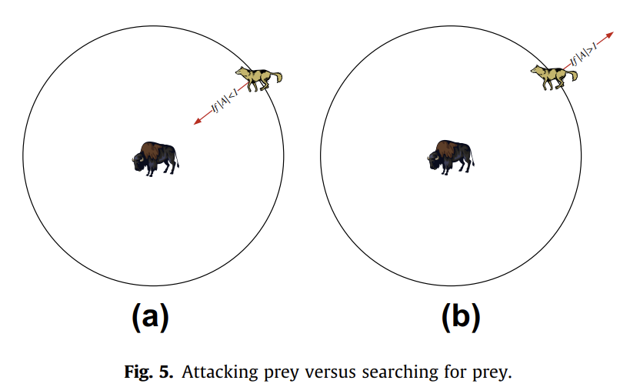
Gray wolf optimizer
4. Attacking prey (exploitation) & Search for prey (exploration)
A is also decreased by a. A is a random value in the interval [-2a, 2a] where a is decreased from 2 to 0 over the course of iterations.
the C vector contains random values in [0,2]. a more random behavior throughout optimization, favoring exploration and local optima avoidance.

Slide 14
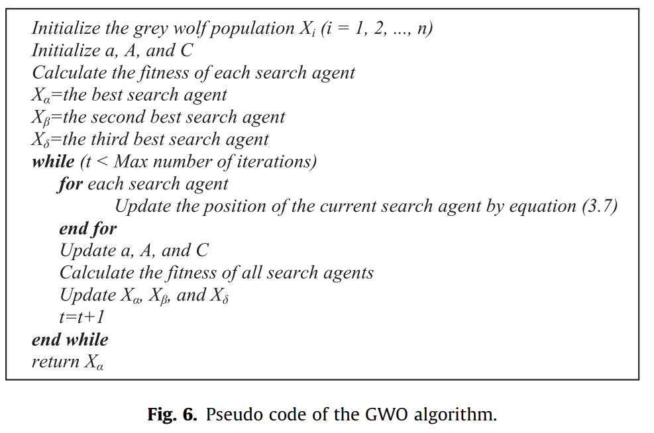
Gray wolf optimizer

Slide 15
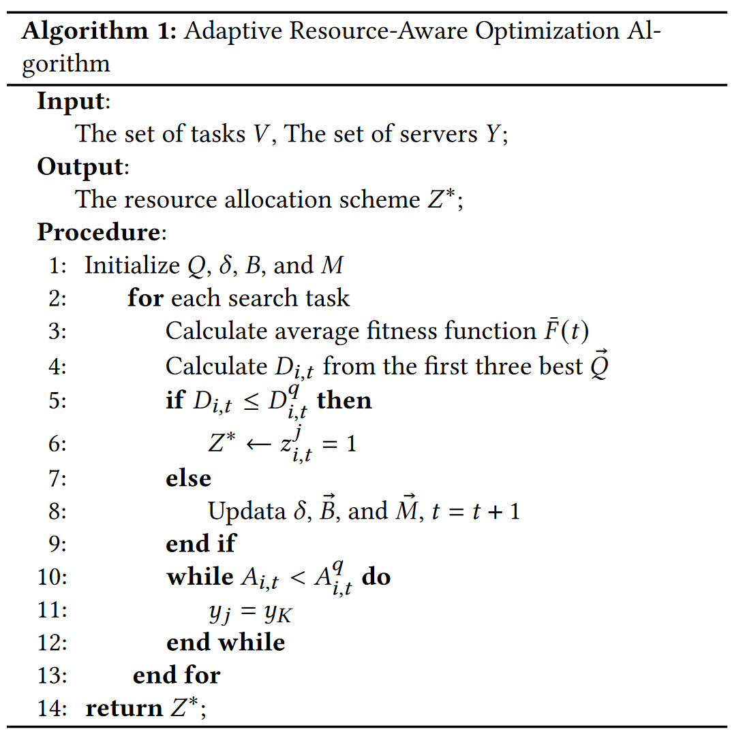
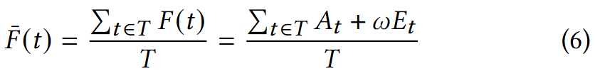
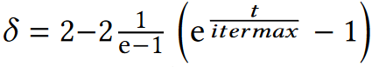
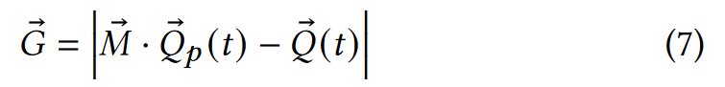
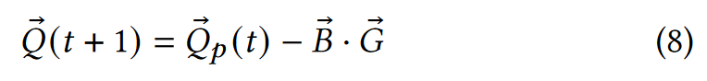
Adaptive Resource-Aware Optimization
4.3.2 Solution Algorithm
the average fitness value：
an adaptive factor：
In the above algorithm, a resource allocation scheme needs to be determined for each task. the complexity of the algorithm is 𝑂 (𝐾𝑆).

Slide 16
Performance Evaluation
Datasets : UA-DETRAC dataset and DAWN dataset
cloud server：one NVIDIA A100 GPU with 40 GB memory
Edge：four NVIDIA Jetson Xavier NX with 8 GB memory
DNN model : Yolov5
Evaluation Metrics:
Accuracy : mAP50, IoU is greater than 0.5
Delay
Energy consumption : inference energy consumption & transmission energy consumption
Baseline Methods：
RDAP : This is a resource deployment method by task aggregation and delay thresholds.
DAO: This is a dynamic adaptive offloading method by adjusting the video bitrate and resolution.
Sniper: This is an inference scheduling method based on time-aware by predicting the inference time of a DNN and guides task scheduling.

Slide 17
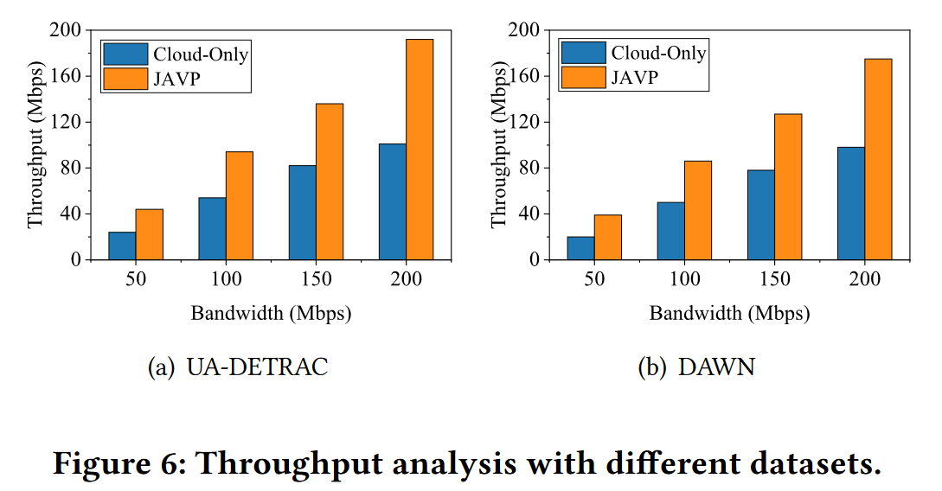
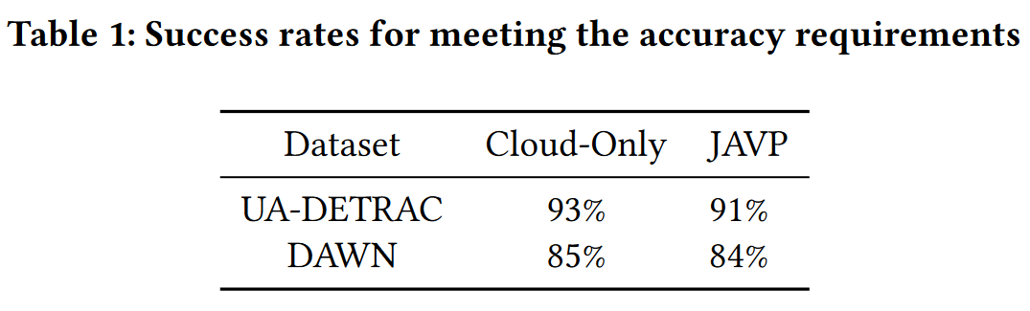
Performance Evaluation
5.2.1 Joint-Aware Advantage Analysis
The range of values for the task accuracy requirements is [0.5,0.8].

Slide 18
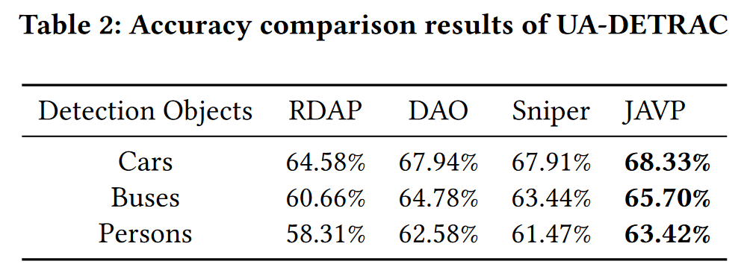
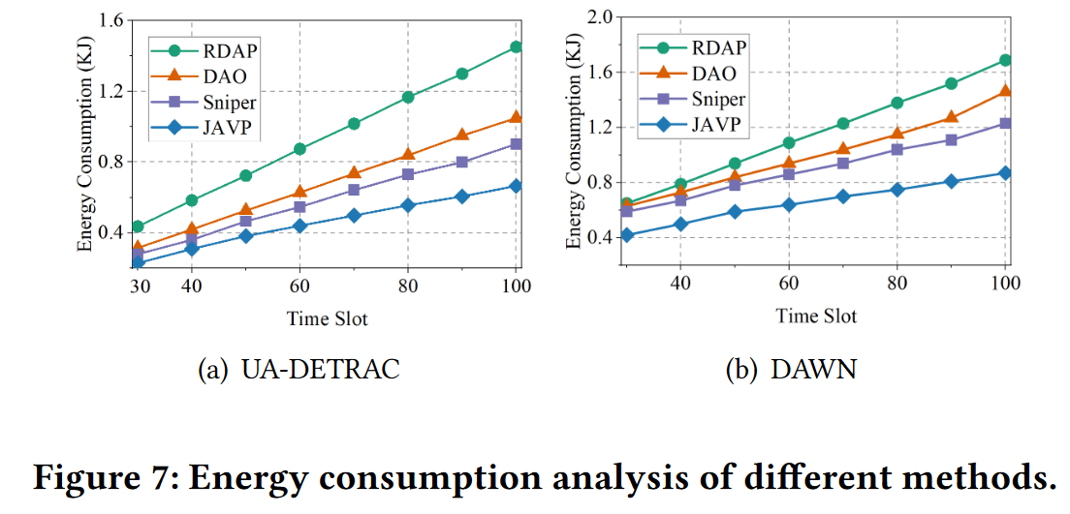
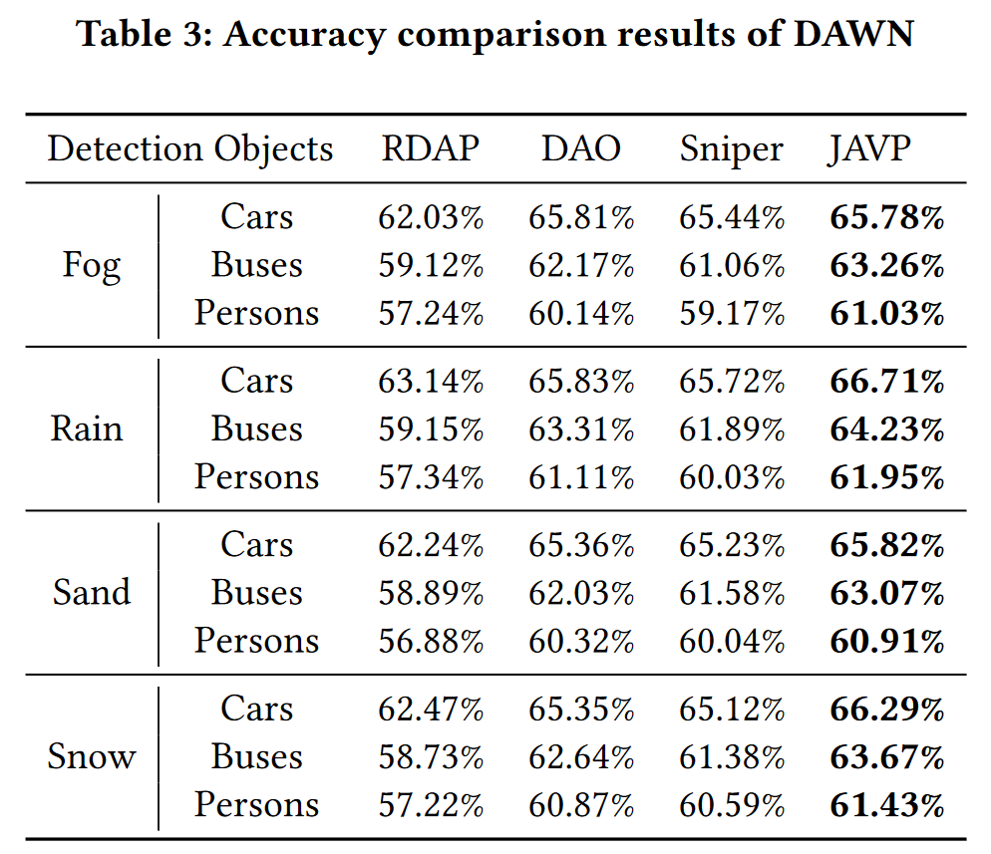
Performance Evaluation
5.2.2 Accuracy-Energy Consumption Tradeoff

Slide 19
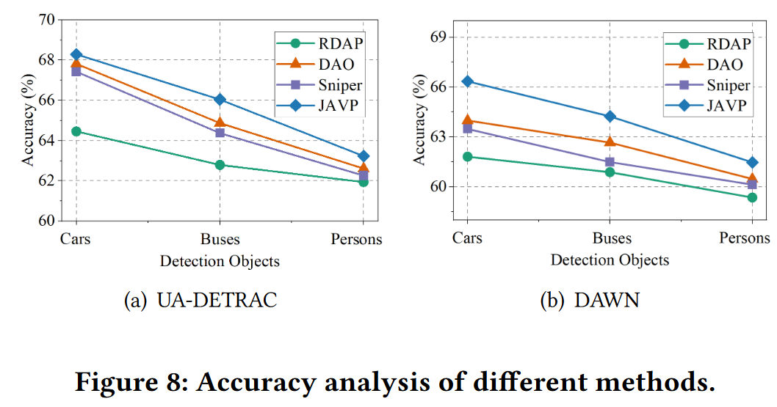
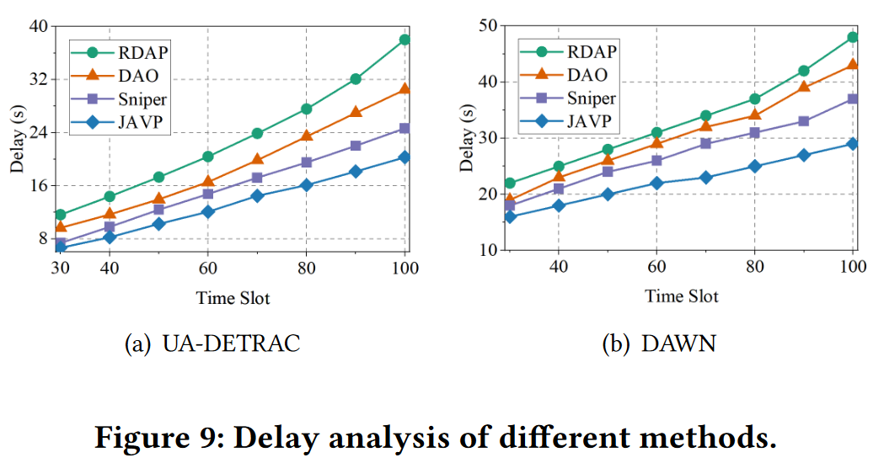
Performance Evaluation
5.2.3 Accuracy-Delay Tradeoff
To test the optimization results of the tradeoff between accuracy and delay, we set the range of delay requirements to [0.2,0.6].
The dynamic allocation of resources can have a significant impact on the delay for task processing.

Slide 20
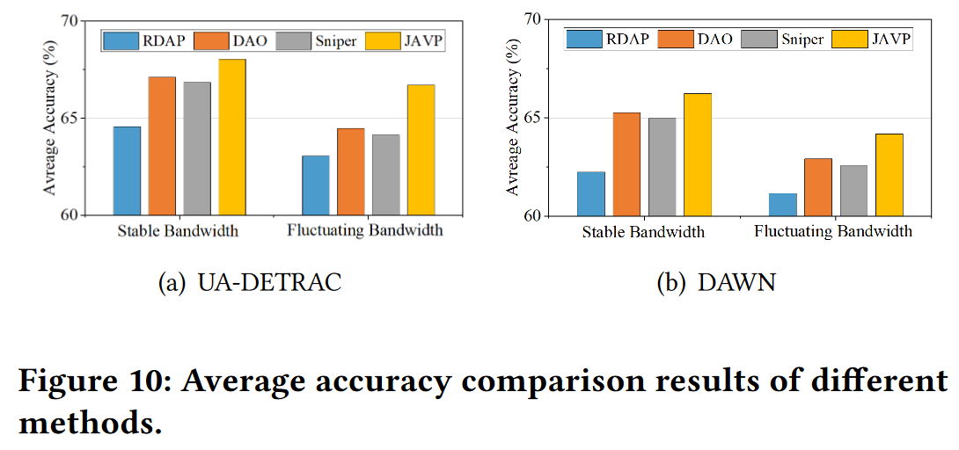
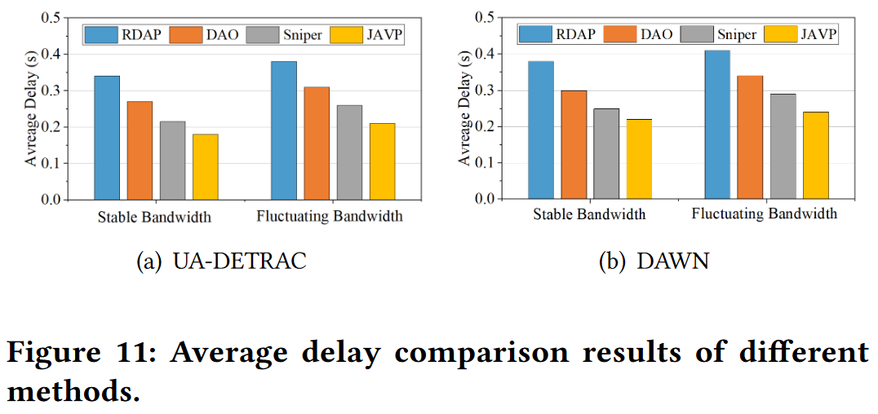
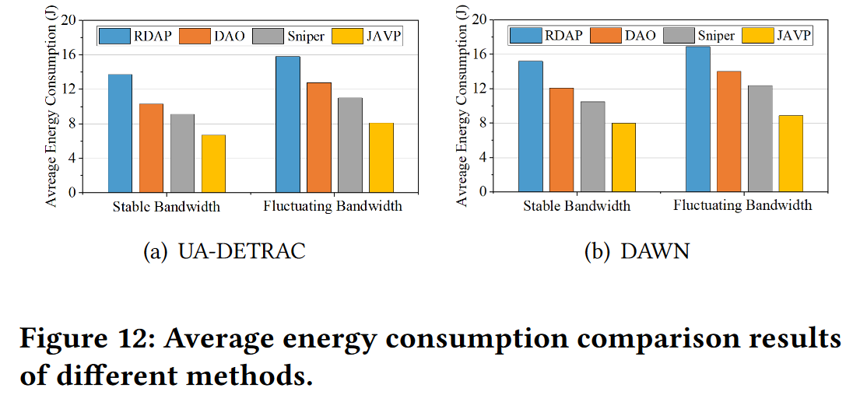
Performance Evaluation
5.2.4 Accuracy-Delay-Energy Consumption Tradeoff

Slide 21
Conclusion
Multiscale complexity-aware analysis and adaptive resource-aware analysis
Distinguish task complexity and schedule tasks based on resource and precision requirements.
JAVP realized the tradeoff between accuracy, delay, and energy consumption.
My view
Analyze the complexity of the task based on RG method.
Introduce an resource optimization algorithm.
The concept of resource awareness is not clear enough.
The form of Q in the optimization algorithm is not explained.

